Slide 1
PDR for Early Career Development Programme (ECDP) participants
Workshop for PDR Reviewers
Summer 2024

Slide 2





Notes:
*Fire alarms and nearest toilets (if delivering in person)
*Getting involved / being prepared to take part in discussions and ask questions
*Phones – how present are you? But understand if someone has urgent personal
*Confidentiality and the programme – Chatham House Rules

Slide 3




Objectives
Develop understanding of ECDP (structure, elements and overall aims)
To increase awareness of PDR purpose and process and how this contributes to ECDP success
To deepen our understanding of the connection and interdependence between ECDP, Academic Promotion and PDR
To discuss some aspects of effective PDR practice, with particular focus on objective setting
Notes:
Summarise learning objectives

Slide 4
ECDP – the ambitions
To develop high achieving, high performing academics in line with World Changers Together strategy
A vehicle to support newly appointed academics to develop their academic skills and progress their careers
Aims to recognise those ambitions by supporting staff to reach Grade 9 within 5-8 years
Annual objective setting along with substantial developmental opportunities provide the back-bone to the programme
ECDP objectives match on to diverse promotion criteria, regarded as exemplary in the sector
Current mandatory elements: PgCAP, Research Integrity, PGR supervisory training
Mentors appointed to provide support and advice to participants throughout the duration of the programme

Slide 5
Timescales
8 years
Grade 9
5 years
Grade 8
3 years
Grade 7
Objective setting and substantial development opportunities
UofG Academic Appointment & Promotional Policy
N.B the clock does not re-set if promotion to G8 is 'late'
Absences/Extensions/Covid

Slide 6
Research & Teaching
Learning, Teaching & Scholarship
Research only
Notes:
Research & teaching – all staff at grades 7 and 8
Learning, teaching & scholarship– all staff at grades 7 and 8
Research only – independent researchers i.e. with PI status, normally grade 8, as confirmed by the VP/Head of College
Partial as well as full membership applies in all three tracks. (Partial membership is unusual – only 11 cases currently)

Slide 7
The Criteria
R&T / RO
LTS
Outputs
Award generation
Supervision
Impact
Learning & Teaching Practice
Leadership, Management & Engagement
Esteem
Learning & Teaching Practice
Scholarship, Knowledge Exchange & Impact
  Scholarly Outputs
  Research Income
  Supervision
Leadership, Management & Engagement
Esteem
Notes:
The three career tracks (but only two sets of criteria)
Not required to meet all - preponderance

Slide 8
The Development Programme
Mandatory Development
PgCAP
Research Integrity
PGR Supervision
Mentoring
Management
Objective setting & PDR
Personal Development Plan
Networking
Communities of Practice
Support
Mechanisms
Recommended
Development
Management Skills Development
Grant writing
Public Engagement
(a range of other development offerings)

Slide 9
Discuss at tables:
Would you approach a PDR for an ECDP participant any differently to that of a non-ECDP colleague?
If so, what might some of the differences be?

Slide 10
Alignment of UofG Processes
PDR
ECDP
Academic Promotion
Review progress, performance and set objectives (all aligned with University wide and local strategic priorities as well as the individual’s developmental and career aspirations)
Progress to Grade 8 and Grade 9 will entail submission to the academic promotions rounds. Academic promotion criteria set the benchmarks for performance at each grade/track and are aligned with University strategy.
The developmental ‘vehicle’ that supports early career colleagues to progress to Grade 9 within a set timescale.

Slide 11
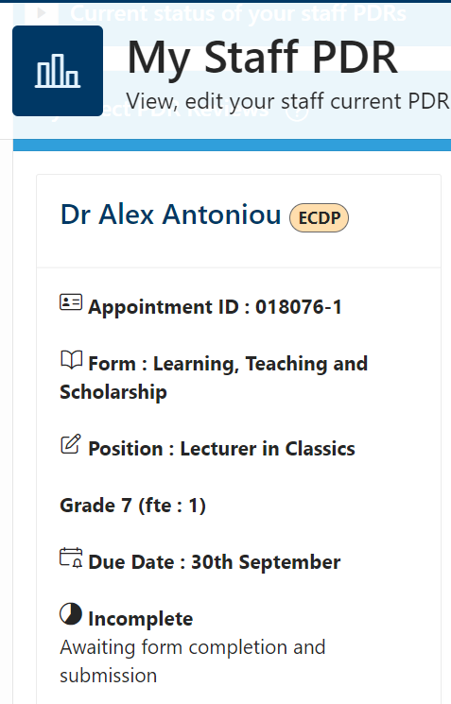

Identifying if a reviewee is enrolled on ECDP
The ECDP tab will detail the following information, bespoke to the individual.
ECDP joining date
Year of ECDP
Promotion application to G8 due at or before (YEAR) if applicable
Promotion application to G9 due at or before (YEAR)
It will also contain links to the ECDP webpages and mandatory elements of the programme

Slide 12
PDR - points to note when reviewing an ECDP participant
When reviewing performance and progress, the reviewer needs to be aware of where the reviewee is within the ECDP timeline.
If close to promotion application being due, how does their evidence fit with the criteria for the next grade. If not close to promotion, is the trajectory on track?
Are they on track with the mandatory elements?
PgCAP/RET - need to have completed for promotion to G9 if on ECDP. Ideally apply no later than 3 years before being due to apply for promotion to G9, as spaces on the course are limited.
Teaching Reduction for PgCAP - 50% Yr1, 25% Yr2

Slide 13
Quality Assurance Process
The VP/HoC (or nominee) with oversight from the ECDP Programme Director, will review a sample of the PDR forms and may communicate feedback and/or require amendments to objectives before endorsing and ratifying progress to the next stage of the programme.
Primary aim is to ensure the required performance standards are understood and support the ECDP participant to achieve them.
Feedback is provided to colleagues and reviewers as appropriate.
If there is insufficient progress towards completion of the programme, there will be dialogue between the VP/HoC (or nominee), the relevant HoS, College HoPOD and the ECDP Programme Director (or nominee), to ensure appropriate support is put in place.

Slide 14
Ratings for ECDP participants
A rating is mandatory for ECDP participants.
Honest, fair, justified, explained and transparent (preparation is key)
Options are:
  Exceptional Performance
  Strong Performance
  Inconsistent Performance
  Improved Performance Required
  *Descriptors for each can be found in the PDR Policy

Slide 15
Setting objectives
Specific
Measurable
Achievable
Relevant
Timed
Notes:
Objectives need to be SMART
They also need to be aligned to the relevant promotional criteria for the track being followed

Slide 16
Setting objectives
Specific
Measurable
Achievable
Relevant
Timed
What needs to be achieved?
Have you provided enough detail to ensure clarity?
What is the expected result?
Notes:
Objectives need to be SMART
They also need to be aligned to the relevant promotional criteria for the track being followed

Slide 17
Setting objectives
Specific
Measurable
Achievable
Relevant
Timed
Could this be measured?
How will you know when it’s been achieved?
What data is available?
What indicators will you look for?
Notes:
Objectives need to be SMART
They also need to be aligned to the relevant promotional criteria for the track being followed

Slide 18
Setting objectives
Specific
Measurable
Achievable
Relevant
Timed
Fit with the local strategic priorities in the context of the role and grade?
Do they need resources? Advise on how to access them if required.
What support is available (who, what, where?)
Notes:
Objectives need to be SMART
They also need to be aligned to the relevant promotional criteria for the track being followed

Slide 19
Setting objectives
Specific
Measurable
Achievable
Relevant
Timed
Link with strategy?
Appropriate for role and grade?
Is it stretching (not business as usual)?
Academically ambitious?
Notes:
Objectives need to be SMART
They also need to be aligned to the relevant promotional criteria for the track being followed

Slide 20
Setting objectives
Specific
Measurable
Achievable
Relevant
Timed
Clear & realistic time frames?
If spanning more than 1 review period – have milestones been set?
Notes:
Objectives need to be SMART
They also need to be aligned to the relevant promotional criteria for the track being followed

Slide 21

PDR – Good Practice
Put adequate time aside (for preparation and the meeting)
Give reviewee plenty of notice
Always ensure the meeting is face to face (online if required)
Contact reviewee beforehand to discuss any areas of focus/enquiry or if a pre-meeting is required
Take time to read form and prepare feedback
If you want support on how to deliver feedback seek advice from local P&OD teams
Give review a deadline for ‘validation’ of form (1 week before meeting)

Slide 22

and finally…
As reviewers you play a critical role in ensuring that our early career colleagues are given the best chance of achieving success and that the university benefits from having world leading talent!

