Slide 1
The meteorite NWA 817 as representative of a Martian crust: What secondary minerals can tell us about the physico-chemical conditions in Mars subsurface
Painting by Don Davis
Helene Breton
School of Geographical and Earth Sciences, University of Glasgow
2^{d} year PhD student

Slide 2
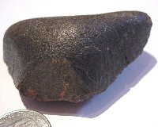
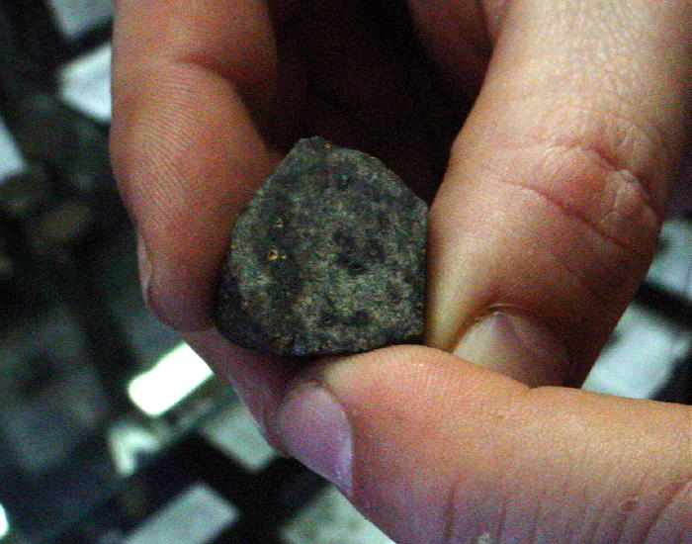

North West Africa 817
Photos of NWA 817 (Bruno Fectay & Carine Bidaut )
Fragment of near-surface Martian crust 1.3 Ga old
Cosmic Rays Exposure age (${}_{}^{3}{He}$, ${}_{}^{21}{Ne}$, ${}_{}^{38}{Ar}$): 10-11 Ma
Found in Saharan desert (Morocco) as a single stone of 104 g by meteorite hunters in 2001

Slide 3
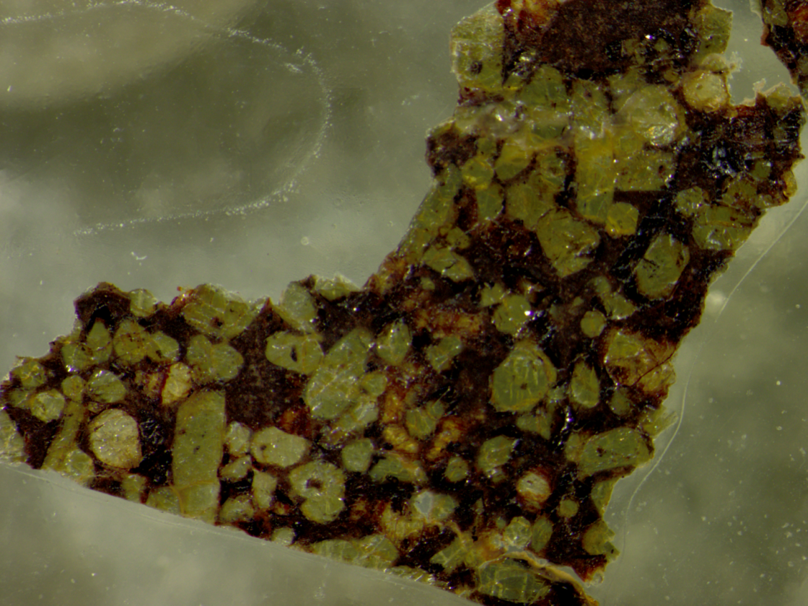
North West Africa 817: a basaltic rock
Basaltic mineralogy:
Pyroxene, olivine and a finely crystallized matrix
Reflective light microscope
Matrix
Pyroxene
Olivine
1 mm
2 cm
Weathering products:
Minerals formed by interactions of igneous minerals with LT aqueous fluids during secondary processes (weathering) on Mars’ surface

Slide 4
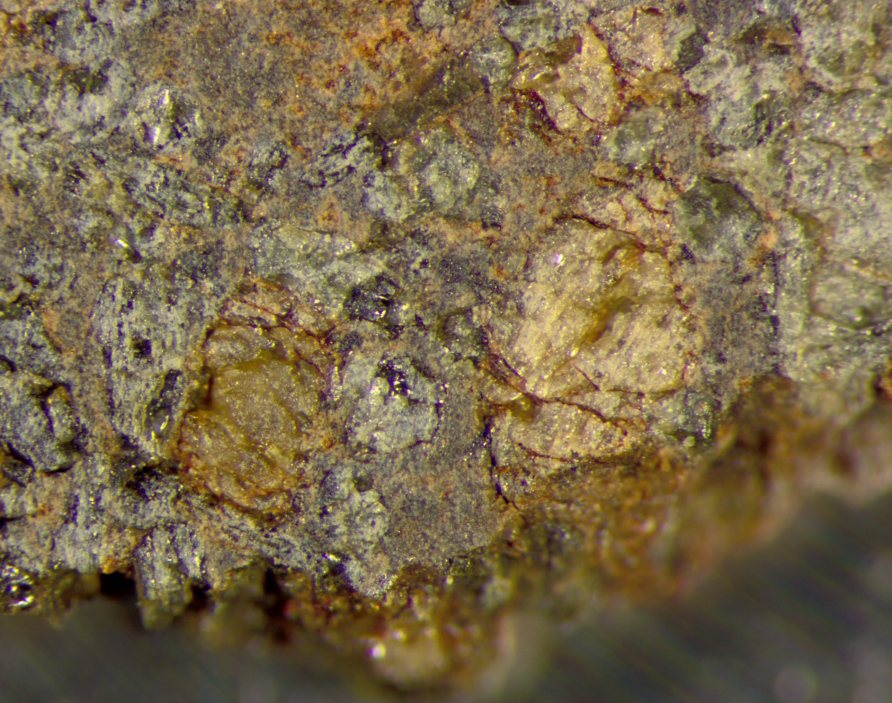
Weathering products distribution
Weathering products are largely distributed
Aqueous fluids have flowed through initial porosity within the matrix
Aqueous fluids have only reacted with the chemically weakest igneous mineral: olivine
Alteration masses
Pyroxene
Olivine
Alteration vein
0.5 mm
Reflective light microscope
→ Aqueous fluids were present but probably only for a short time

Slide 5
Chemical weathering of olivine
SEM/SE
SEM/BSE
Olivine
Vein
5 µm
5 µm
200 µm
Corrosion texture on olivine surface
Funnel-shaped features: leaching of Fe and Mg
Water moved into micro-openings dissolving olivine and precipitating secondary minerals in equilibrium with the near-surface environment

Slide 6
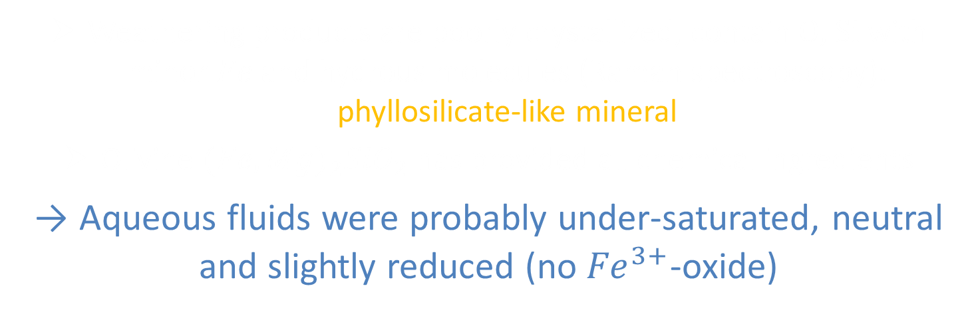
Chemistry of weathering 1
Si
O
Fe
Mg
50 µm
SEM/EDS
Weathering products are poorly crystallized, contain $O,$ $Si$ with minor $Fe$ and hydrous molecules (Raman spectroscopy): phyllosilicate-like mineral
Olivine ${(Fe,Mg)}_{2}{SiO}_{2}$ has provided all chemical ingredients
→ Aqueous fluids were probably under-saturated, neutral and slightly reduced (no ${Fe}^{3+}$-oxide)

Slide 7
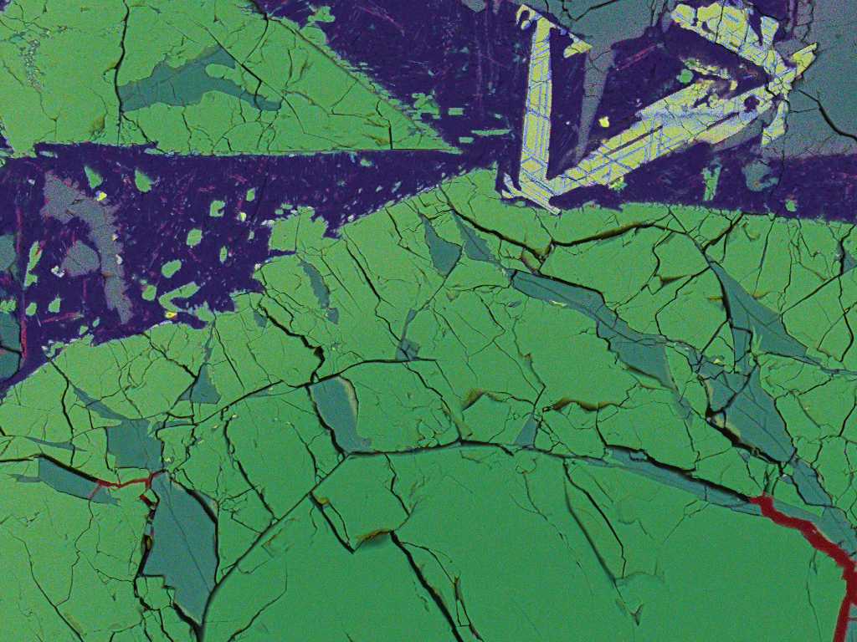
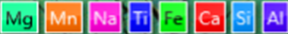
Chemistry of weathering 2
SEM/EDS
100 µm
Weathering products contain Mn-rich carbonates
Carbonates have probably largely been dissolved away by terrestrial aqueous fluids

Slide 8
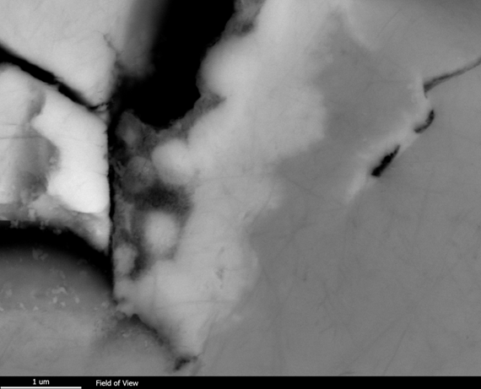

Weathering products relationships
SEM/BSE
SEM/BSE
Coarser
Porosity
Olivine
Finer
10 µm
Vein
1 µm
$Mn$-carbonates crystallized after phyllosilicate-like material
The phyllosilicate so far in equilibrium with the environment became unstable and dissolved away
→ Change in fluid conditions (more alkaline and reduced)

Slide 9
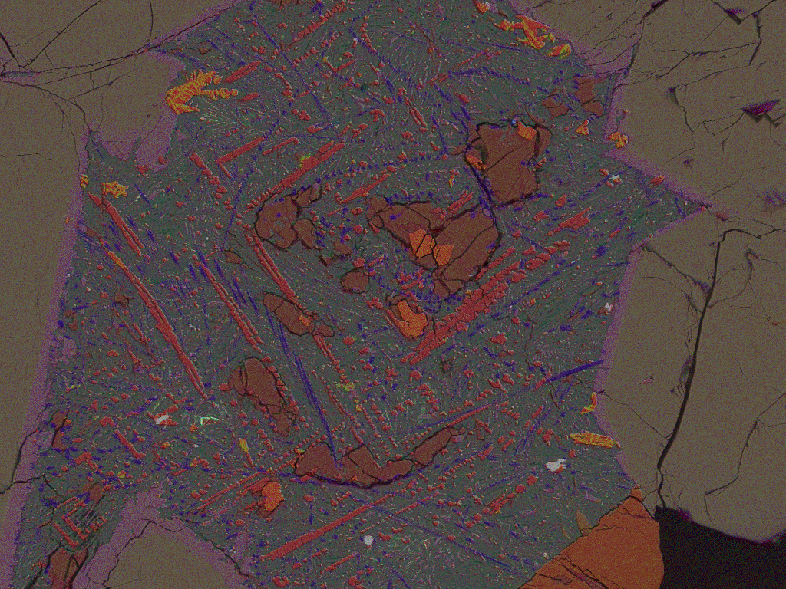
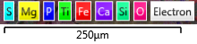
Chemistry of weathering: olivine vs. matrix
SEM/EDS
Alteration masses
Same chemica composition
No Fe-Mg-rich minerals: efficient drainage
Only traces of Mn and C in the matrix alteration products: lower pH, less reduced conditions or higher water flow?

Slide 10
Martian vs. Terrestrial
SEM/BSE
Fusion crust
Fragment of olivine with alteration products
Calcite veins
200 µm
Martian alteration products: phyllosilicate + Mn-rich carbonates
Terrestrial alteration product: calcite

Slide 11
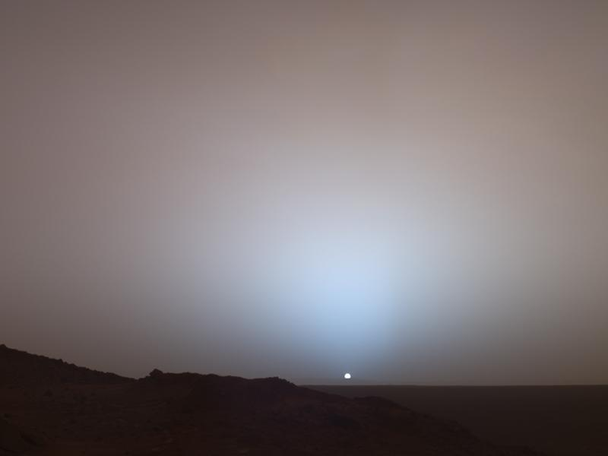

The geological conditions of weathering
During the last billion year, aqueous fluids were present at some point(s) in Mars subsurface
They were probably under-saturated (${CO}_{2}?)$, neutral, slightly reduced and flowing but not present for a long time
Carbonates precipitation shows a change in fluid conditions either local (within olivine veins) or global (different aqueous events and water sources)
Weathering products in the Martian subsurface suggest that acidic weathering was restricted to the surface
Thank you!
Photograph of a Martian sunset (Mars Pathfinder, credit: NASA)

