Slide 1


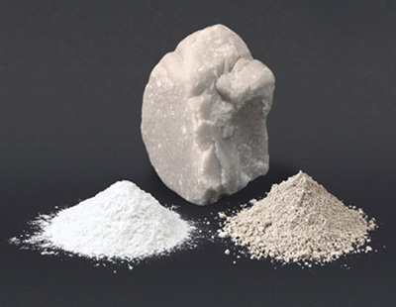
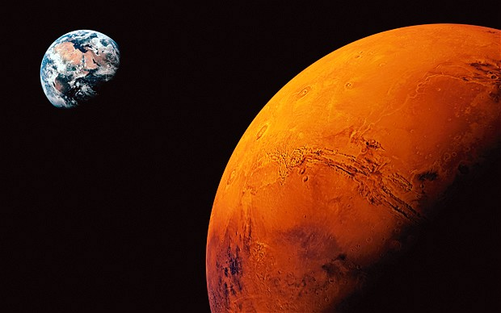

Carbonates replacing plagioclase glass in the Martian meteorite ALH84001
Macartney¹, T. Tomkinson¹, E.R.D. Scott², M.R. Lee¹,
¹School of Geographical and Earth Sciences, University of Glasgow, UK, Email: a.macartney.1@research.gla.ac.uk
²Hawai’i Institute of Geophysics and Planetology, USA.
O
Carbonate: CO₂ + H₂O = CO₃⁻²
=
+ Mg²⁺ Ca²⁺ etc. Creates
(CaMg)(CO₃)₂
-
C
-
-O
O-
Martian implications?
On Earth they form either by fluid deposition
or biological activity
Both offer insight to Mars’ history
But are the carbonates in ALH 84001 biological?

Slide 2
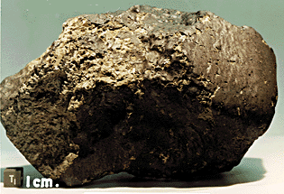
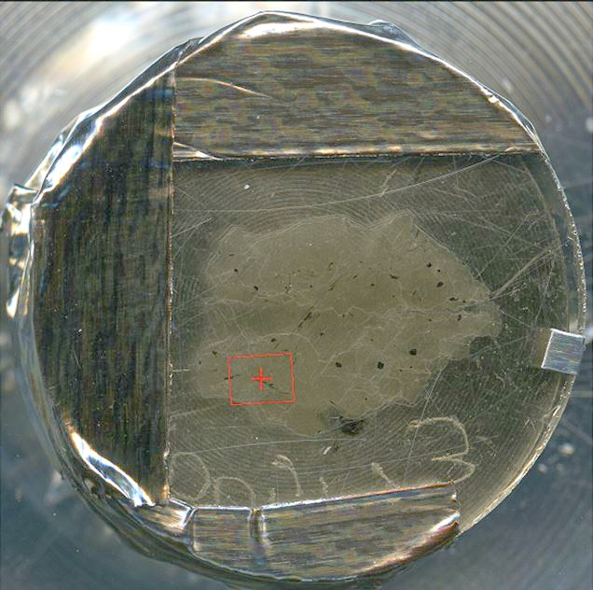
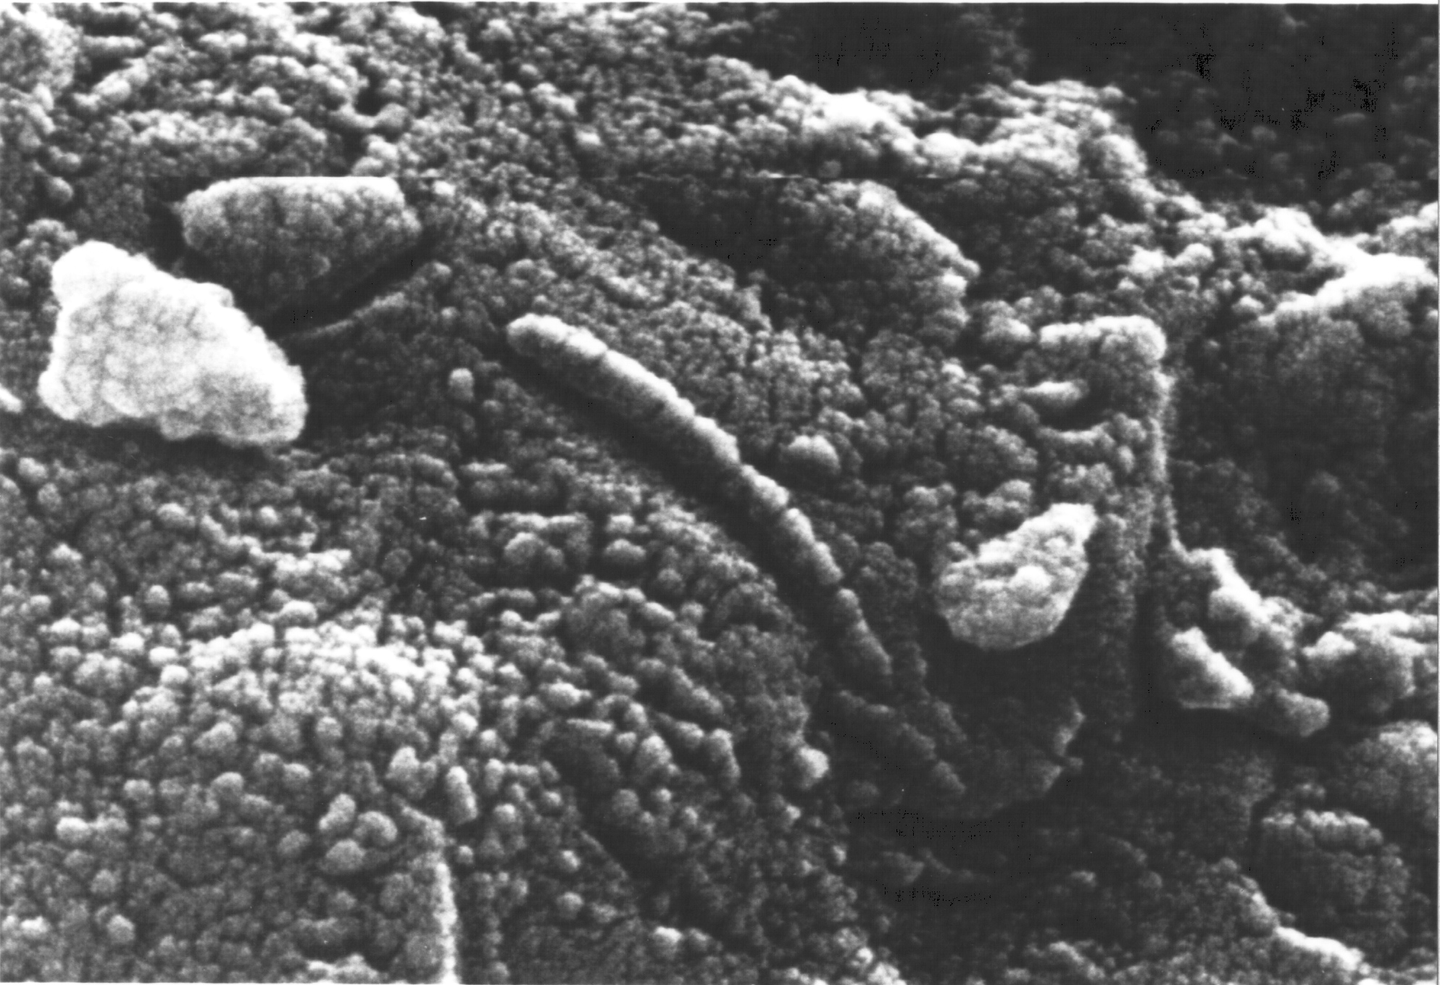
Discovered in Alan Hills, Antarctica, 1984 weighing 1.93 kg
Dated at 4.091 ± 0.030 billion years
Misclassified as a diogenite until 1994
McKay et al. 1996 proposed fossil bacteria in the carbonates
ALH 84001 173
The most controversial piece of Mars?

Slide 3
Intensive multiple
shock
deformation.
Fluid and glass
ingress

Slide 4
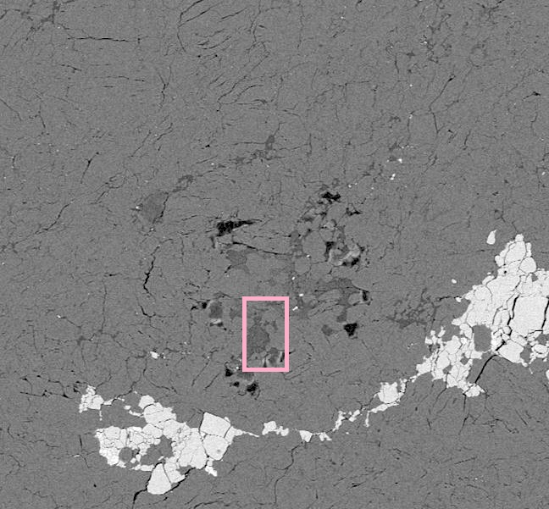
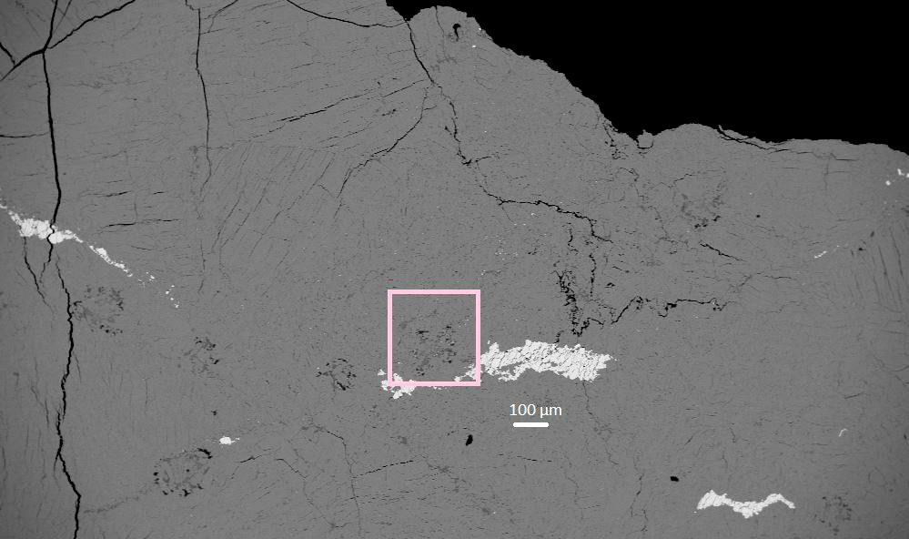
Clusters of pore space from remnant
grains now filled with feldspathic glass
and carbonate surrounded by
orthopyroxene grains

Slide 5
Overview of carbonate formation possibilities
1.) Biological with associated fossil or shell evidence
unrelated to glass
2.) Cementation and occlusion in pores from low temperature allochthonous fluids
unrelated to glass
3.) Solidification contemporaneous with impact melt glass at high temperature
non-biological and unconducive to life
4.) Replacement of glass at low temperatures (~150°C)
non-biological but potentially conducive to life

Slide 6
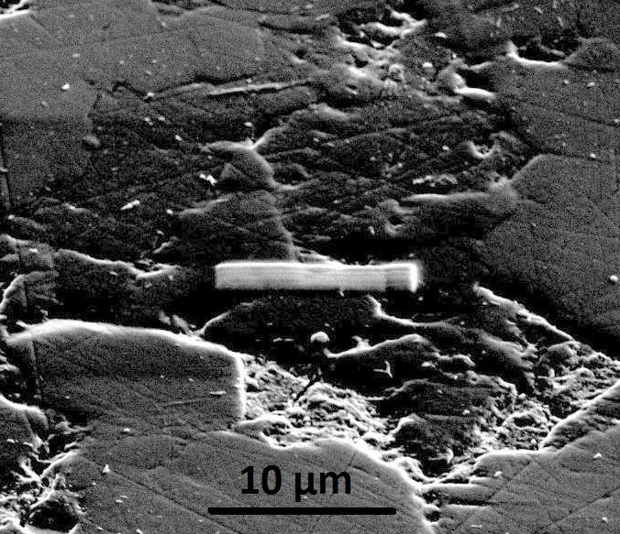
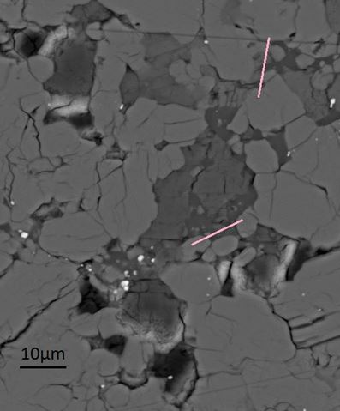
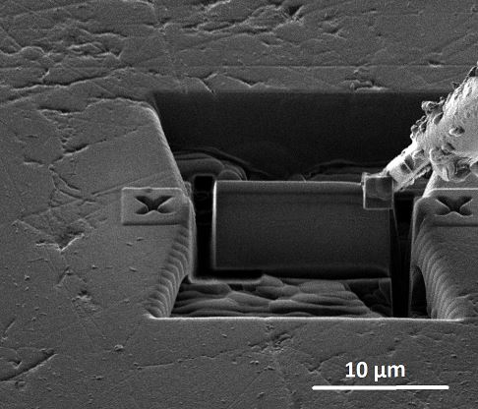
Oscar Wilde
on geology:
If you’re going
to FIB,
better to make it
provocatively
interesting and varied,
with the potential
to incite at least
a little scandal
FIB:
Focussed Ion Beam

Slide 7
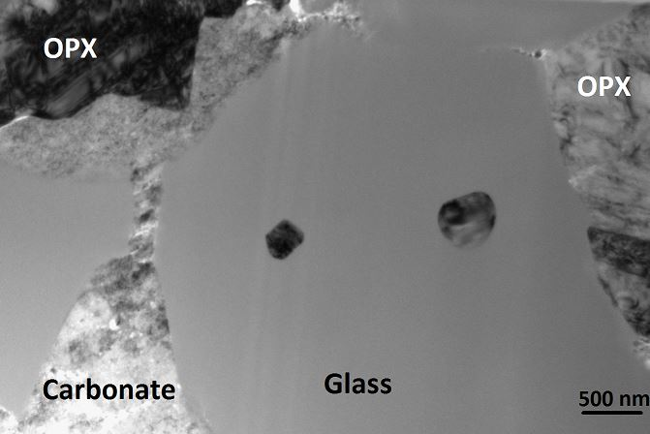
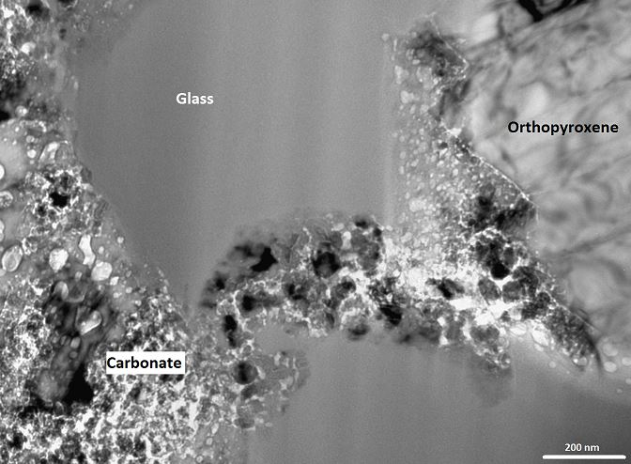
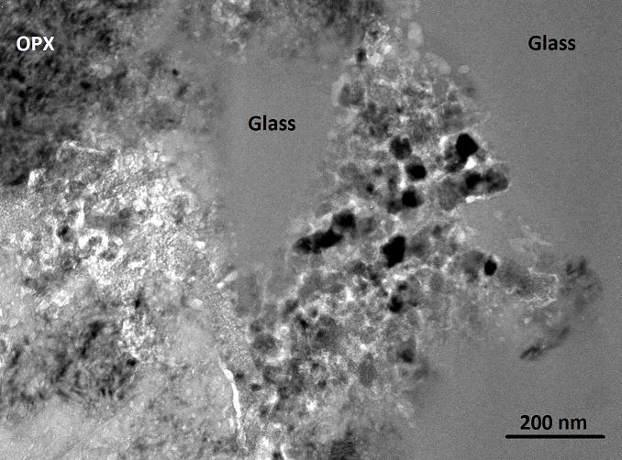
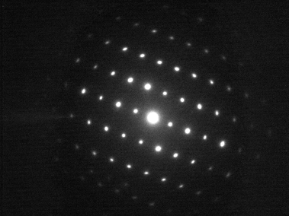
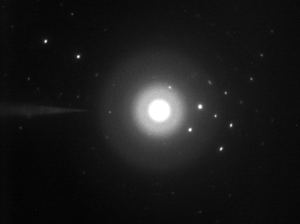
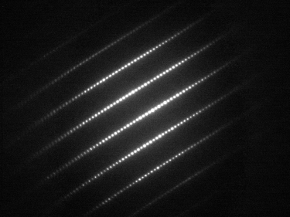
Transmission Electron Microscope (TEM) imaging and Bragg diffraction identification
200 nm
Carbonate
Glass
Orthopyroxene
Interpretation: Carbonates cross cuts and replaces glass via lines of pre-existing weakness

Slide 8
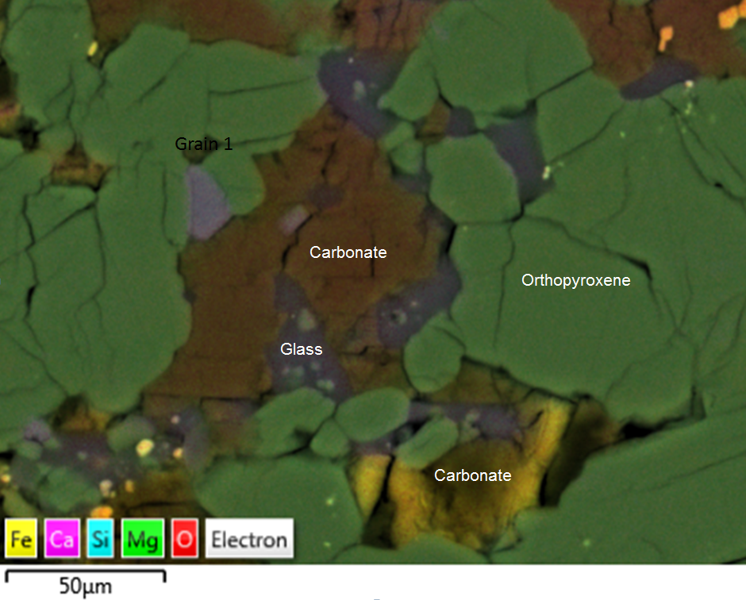
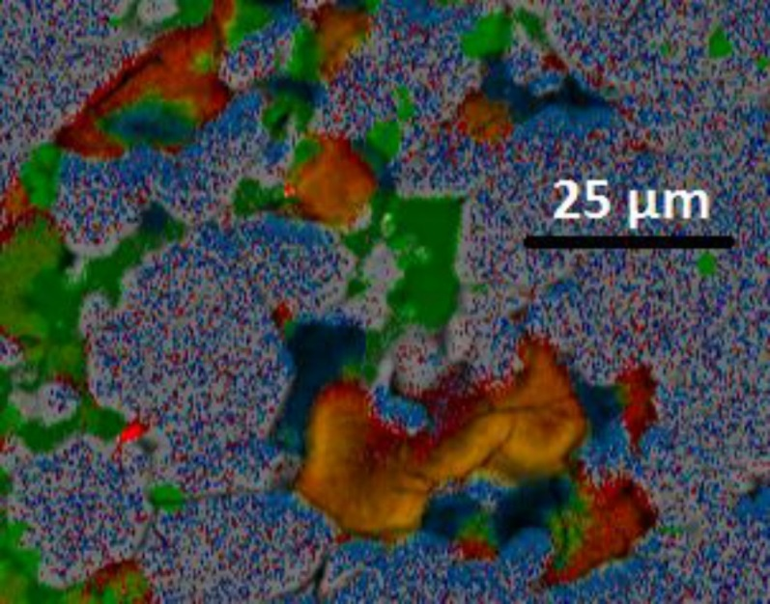
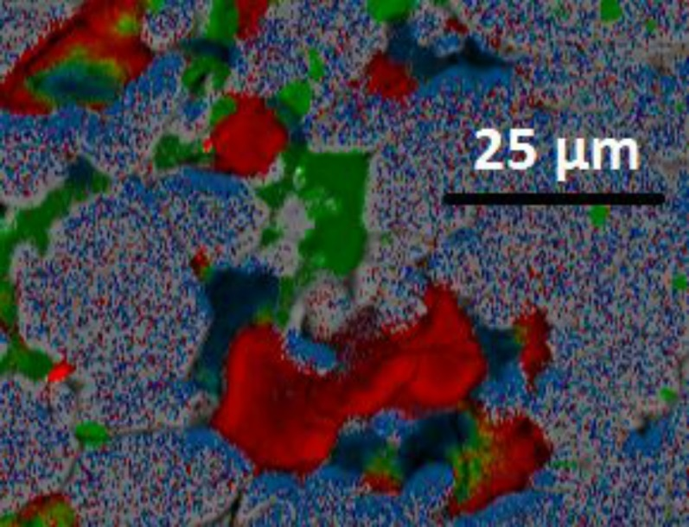
Scanning Electron Microscope (SEM) X-ray mapping
highlight Ca-Mg-Fe carbonate zonation

Slide 9
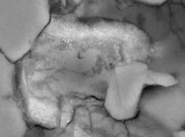
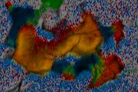
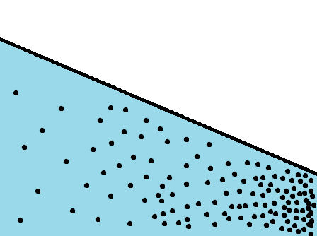
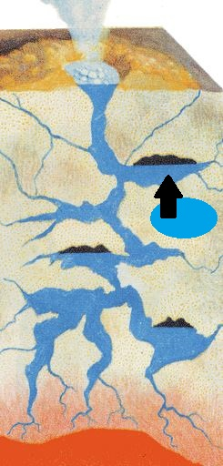
Cause of carbonate zonation?
Depleting water to rock ratio (W:R) or Drop in system pressure
Causes cation density to increase

Slide 10
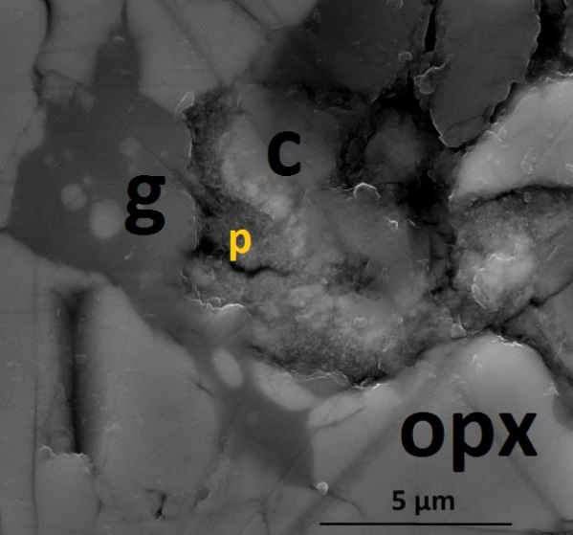
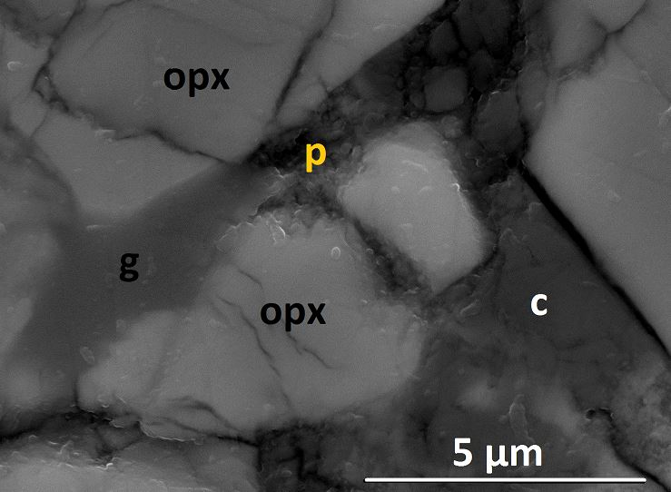
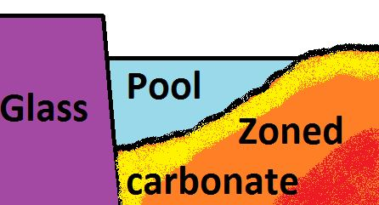
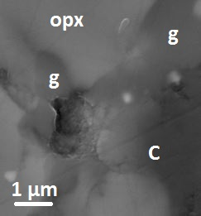
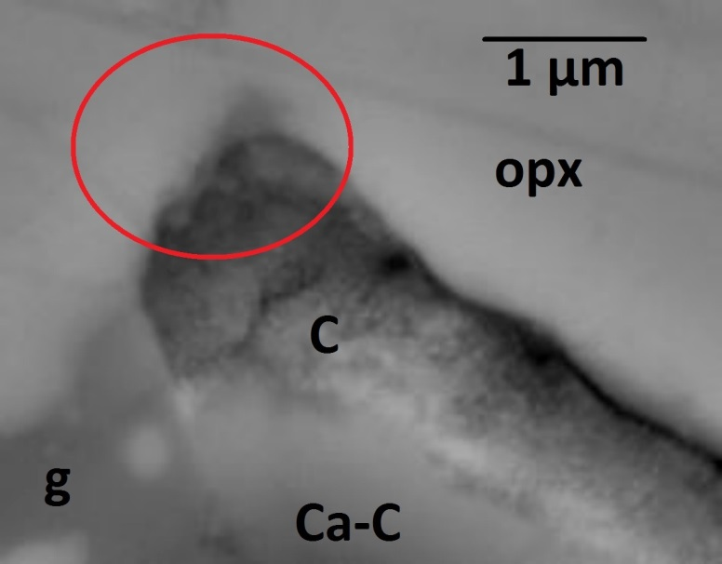
Feldspathic glass-carbonate interface characterized by pore space ‘depressions’ interpreted as former
cation rich fluid pools.
Glass releases cations
into the fluid pool
and carbonates
precipitate out.

Slide 11
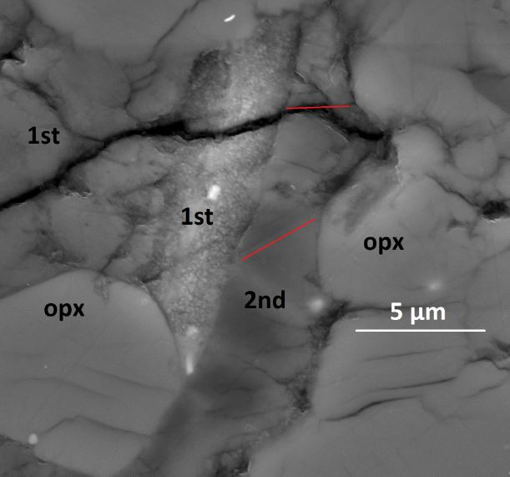
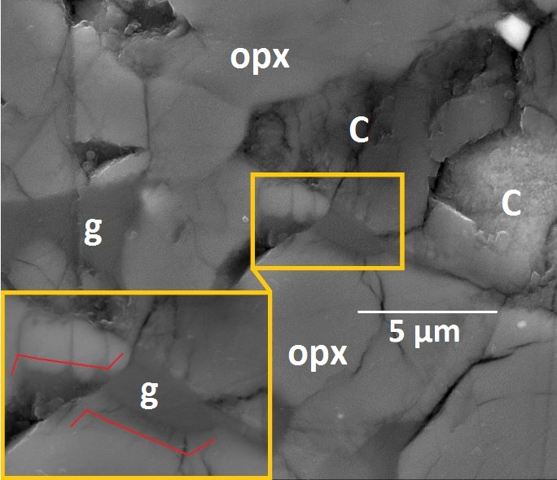
Generational sequences
Unreacted glass…. Lack of fluid in the system?

Slide 12
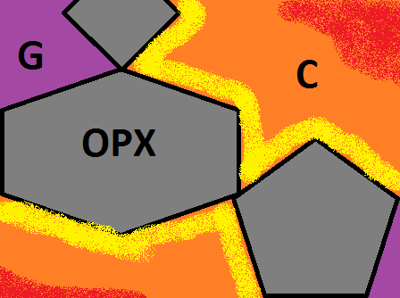
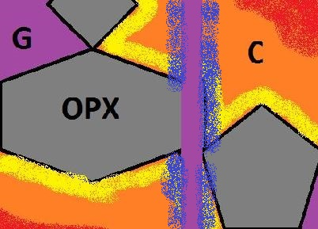
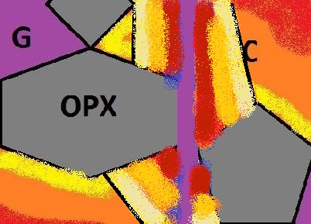
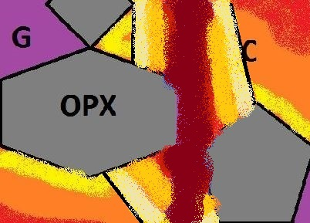
Summary of multiple generation carbonate sequences
1.)
Pre-existing
carbonate
Structures
and glass
2.)
Impact crack.
Intrusion by
melt glass and
fluid
3.)
Second generation carbonates form due to glass-fluid interaction
4.)
Glass is fully replaced by carbonate if enough fluid is available

Slide 13

Conclusions
Multiple shock history of ALH84001
Carbonate zoning due to W:R changes or pressure drops
Impact melt glass abiotically replaced by carbonate only when fluid available
No evidence for little aliens in ALH 84001… but a beautifully complex history of overlapping, chemically distinct, generations of glass and zoned carbonates

Slide 14


Astrobiology Workshop 2015
'Building Habitable Worlds'
25th February 2015
Venue: Glasgow Science Centre
Free Registration
Website: http://www.astrobiology2015.moonfruit.com/

