Slide 1
Guidance notes – delete slide before presenting
These UofG marketing slides are intended to support staff who are making presentations about Lord Kelvin’s Bicentennial. These slides are pre-populated with text and full screen images. You will be able to see the options by scrolling down the left-hand side.
A selection of the University’s brand colours has been pre-loaded for your text and tables. These are the eight top colours (‘Theme colours’) plus black & white in the font colour drop-down menu.
These slides have been designed to be accessible to all, meeting our legal requirements on digital accessibility. You will have to add your own text (title and body text) to make these pages comply with accessibility guidance. For more information see
glasgow.ac.uk/myglasgow/digitalaccessibility/documents/powerpoint

Slide 2



Slide 3
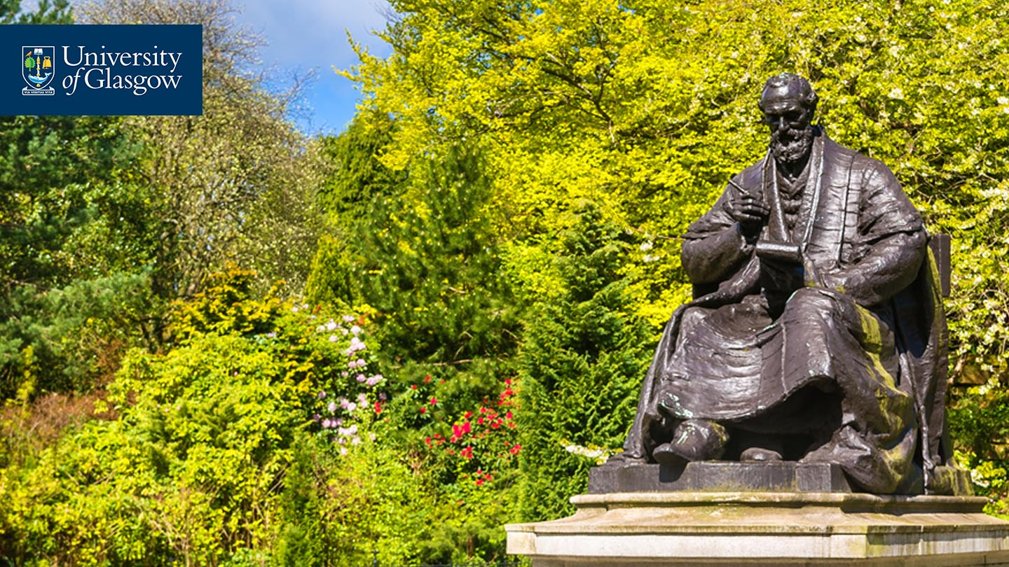
Lord Kelvin 200
In 2024 the University of Glasgow is marking the 200th anniversary of pioneering scientist and businessman William Thomson (Lord Kelvin) with a series of events.
Lord Kelvin was Professor of Natural Philosophy at the University of Glasgow for 53 years, from 1846 to 1899. His discovery work on heat and temperature created the science of thermodynamics and his applied work made possible transatlantic communication.
Visit glasgow.ac.uk/explore/lordkelvin200 for more information about the man and his achievements, his lasting legacy and the celebrations planned.

Slide 4
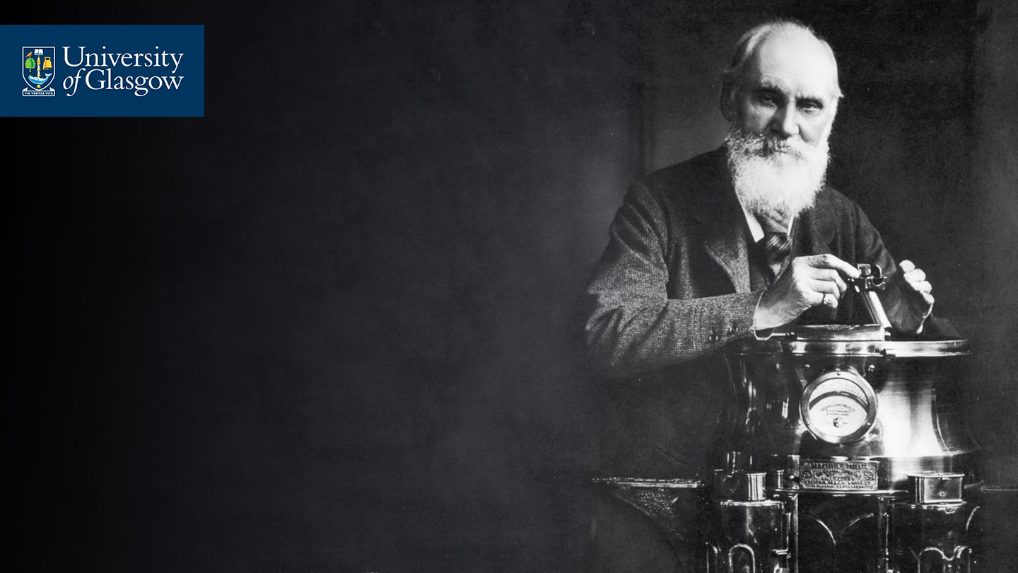
We recommend that you use headings or bullet points.
Your audience want to hear and see you present not read from a slide.
To insert an image, right-click (ctrl + click Mac) and select ‘send to back’, to place it behind the University marque at the top.

Slide 5
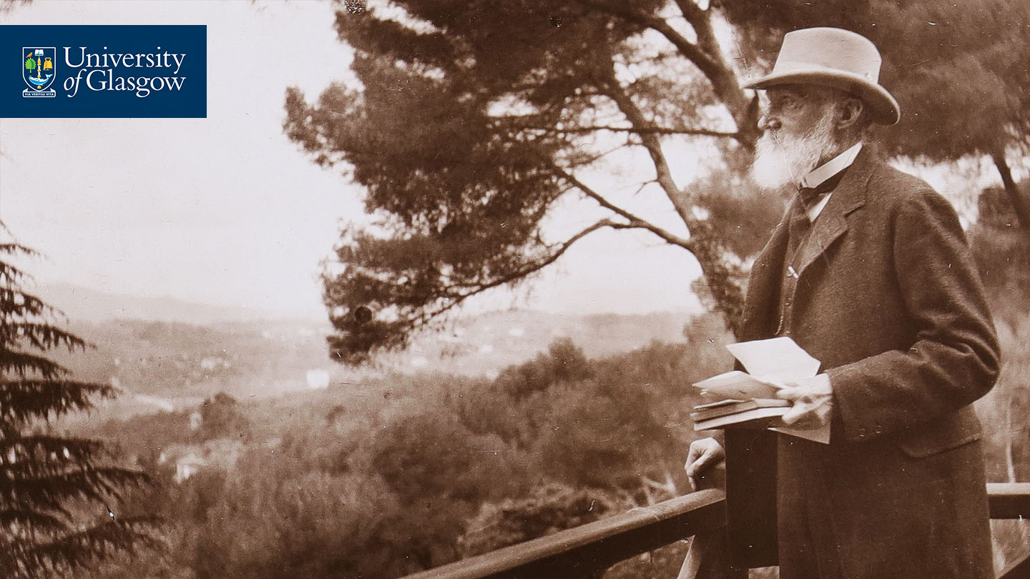
We recommend that you use headings or bullet points.
Your audience want to hear and see you present not read from a slide.
To insert an image, right-click (ctrl + click Mac) and select ‘send to back’, to place it behind the University marque at the top.

Slide 6
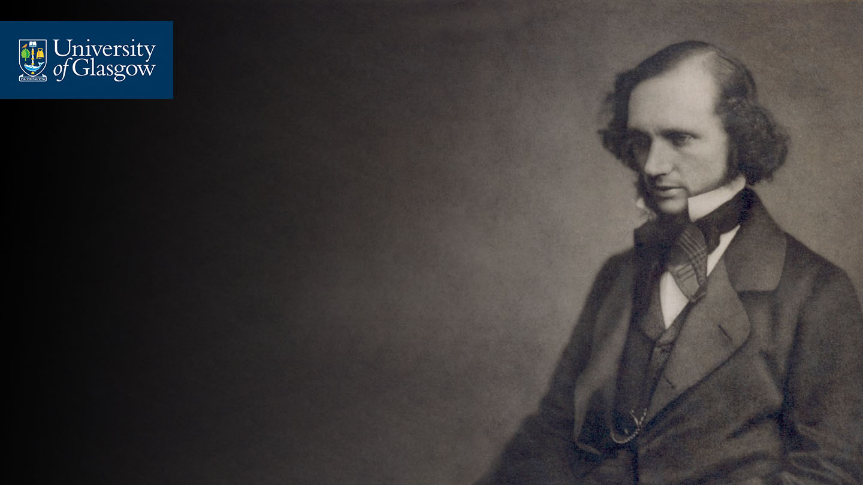
We recommend that you use headings or bullet points.
Your audience want to hear and see you present not read from a slide.
To insert an image, right-click (ctrl + click Mac) and select ‘send to back’, to place it behind the University marque at the top.

Slide 7
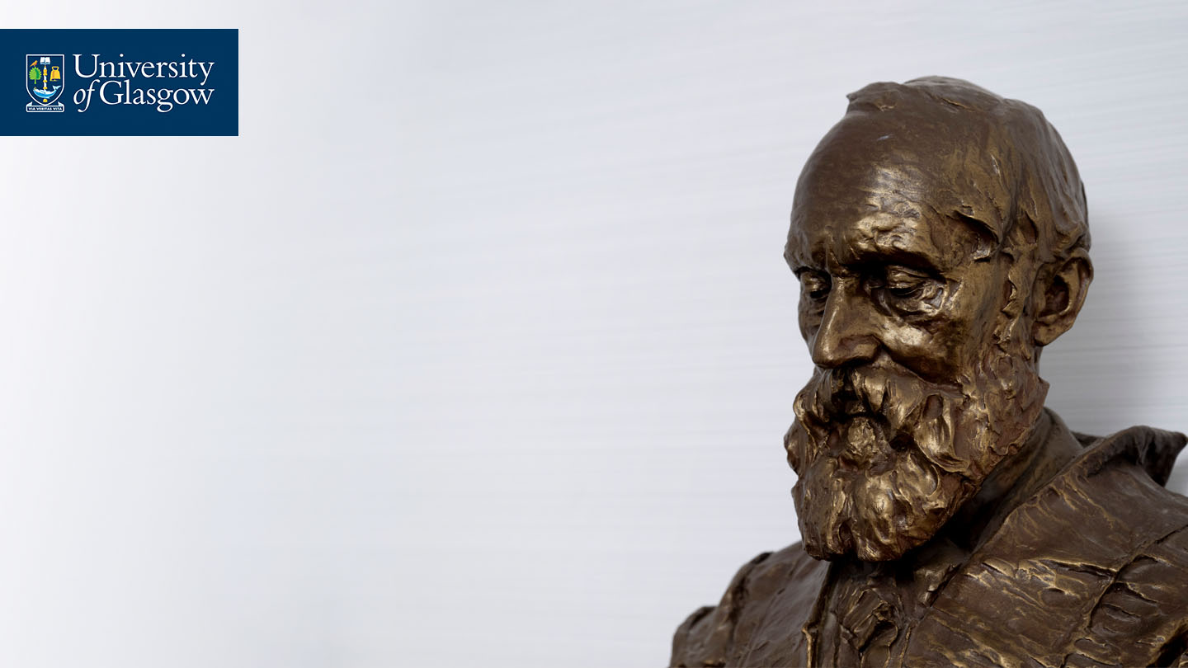
We recommend that you use headings or bullet points.
Your audience want to hear and see you present not read from a slide.
To insert an image, right-click (ctrl + click Mac) and select ‘send to back’, to place it behind the University marque at the top.

Slide 8

We recommend that you use headings or bullet points.
Your audience want to hear and see you present not read from a slide.
To insert an image, right-click (ctrl + click Mac) and select ‘send to back’, to place it behind the University marque at the top.

Slide 9

We recommend that you use headings or bullet points.
Your audience want to hear and see you present not read from a slide.
To insert an image, right-click (ctrl + click Mac) and select ‘send to back’, to place it behind the University marque at the top.

Slide 10
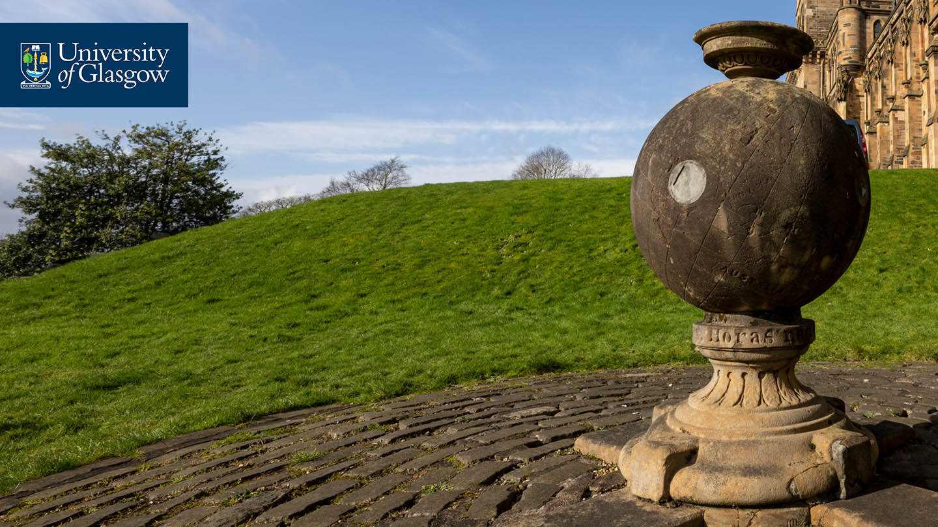
We recommend that you use headings or bullet points.
Your audience want to hear and see you present not read from a slide.
To insert an image, right-click (ctrl + click Mac) and select ‘send to back’, to place it behind the University marque at the top.

Slide 11
We recommend that you use headings or bullet points.
Your audience want to hear and see you present not read from a slide.
To insert an image, right-click (ctrl + click Mac) and select ‘send to back’, to place it behind the University marque at the top.

Slide 12




Closing slide – You can add contact details, a call to action or a simple thank you.
#Kelvin200

